Slide 1
Enviro-Save – Humanity
We are the manufacturer of the
Enviro-Save Engine & Power train
Protection Metal Treatment.
Its for Life
Guaranteed & Proven since 1990
Common Sense Cost Reducer
Going Green Has Never Made More Sense
Time to wake up, our children’s future depends on us to go Green

Slide 2
Common Sense Cost Reducer Enviro-Save Metal Treatment
One Time Investment and Enviro-Save products reduce pollution, friction, drag, metal wear, heat, oil and fuel consumption, proven with Scientific Oil Sample Analysis.
Friction is the major cause of engine, transmission and differential wear and tear. It robs horsepower, robs fuel and increases global pollution.
Friction is also a major contributor to engine and mechanical component heat and metal fatigue.
Enviro-Save has a full line of One Time Application products that reduce friction, drag and wear by 50% and more, normally increases life by 2 or 3 times !

Slide 3
Common Sense Cost Reducer & Pollution Reducer
Enviro-Save Metal Treatment achieves these results by cleansing the surface asperity of all bearing surfaces and permanently makes all bearing surfaces smoother.
This is called the Impregnation Process. Once this process has been completed it remains in the bearing surfaces for the entire life of engines, transmissions, differentials etc.
The positive results are proven and guaranteed since 1990.
Normally extends vehicle & component life by 2 or 3 times
This technology is available today through Distributors or Enviro-Save Distribution & Mfg. Inc.

Slide 4
Common Sense Cost Reducer & Life Enhancer
Enviro–Save can be used in any engine and drive-train platform without the risk of voiding warranties.
Its positive uses have been extremely well documented since 1990

Slide 5
Common Sense Cost Reducer & Dependability Enhancer
This technology is available today.
Start today to save money in many ways.
Start today to save wear and tear on your vehicles.
Start protecting your investment today.
Return on Investment runs into the 1000’s of %.

Slide 6
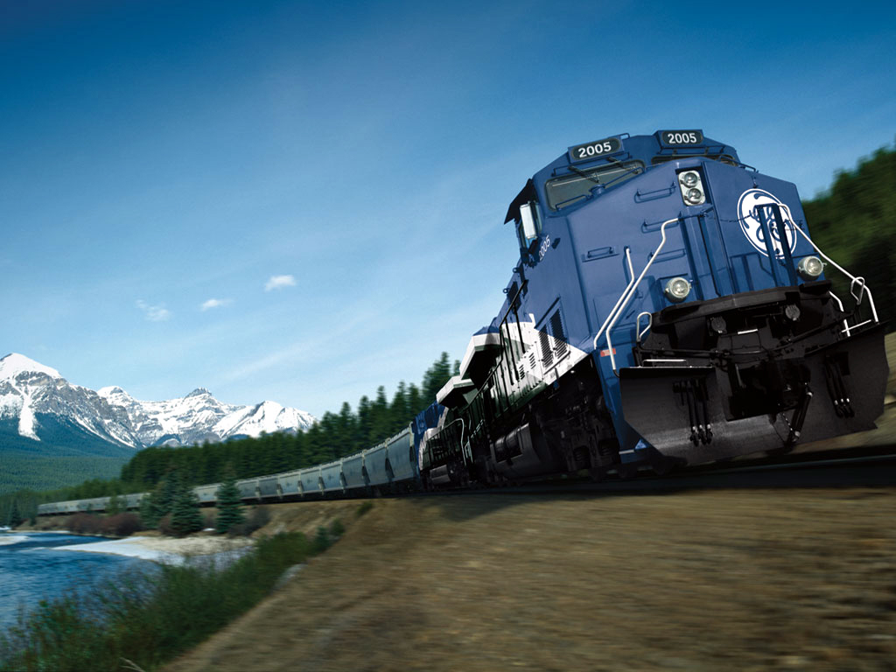
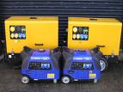
Common Sense Cost Reducer & Performance Enhancer
From Trains
Enviro-Save is used in 100’s of applications
To Generators.
Who says size doesn’t matter. .
We do.

Slide 7
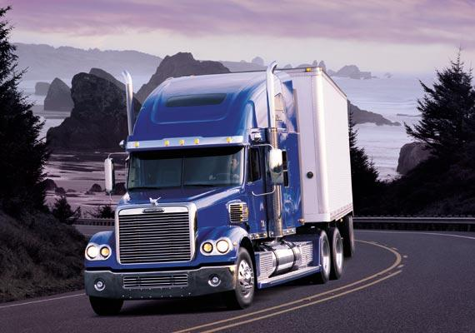
Common Sense Cost Reducer & Profit Enhancer
From Semi Trucks
Common Semi Truck Fuel Savings 6% to 9% - Auto’s 10% to 15%
To Refrigerated Trailers.
The results are Guaranteed

Slide 8
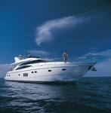
Common Sense Cost Reducer & Environment Protection
From Farm Equipment
Less Exhaust Pollution
Less Fuel / Oil Consumption
To Motor Yachts
Less Oil In Water

Slide 9
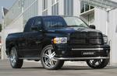
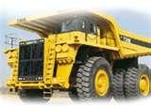
Common Sense Cost Reducer Enviro-Save Metal Treatment
From Work Trucks.
To Land Movers.
It works in all of them & more… Lawn Mowers-Pressure Washers

Slide 10
Common Sense Cost Reducer You will not be disappointed
Saving Energy and the Environment for the Next Generations
Questions? - call
Warren Casperson, CEO/President
604 522 8836
www.envirosaveglobal.com
www.savefuelclass8.com
Enviro-Save Distribution & Mfg. Inc.
410 Canfor Avenue
New Westminster, B.C. Canada V3L 5G2

